Slide 1
XYZ Loan Lending
Classification Model

Slide 2






XYZ Corp Lending Loan– Project Charter
Imarticus Learning
Define – Measure – Analyze – Design - Verify
Problem Statement
Purpose
Data Modeling Milestones
Whenever an individual/corporation applies for a loan from a bank (or any loan issuer), their credit history undergoes a rigorous check to ensure that whether they are capable enough to pay off the loan .
Based on the amount of risk that the issuer is willing to take (plus some other factors) they decide on a cutoff of that score and use it to take a decision regarding whether to pass the loan or not.
1
Business Understanding
To develop a Classification model which would help to predict the defaulters at the initial screening level based on their credit history.
2
Analytic Approach
3
Data Requirements
4
Data Collection
Objective
Project Team
Solution Identified
5
Data Understanding
To build a health check mechanism based on similar features, that if in future an individual applies for a loan with almost same credit history, will he default or not based on the loan cutoff as decided by the bank
6
Data Preparation
Project Team Members
Pooja Anand
Anil Mehra
Dinesh
Prepared a classification model based on available data and based on “date”, split it into training dataset and test dataset and build 3 classification models.
Out of 3 classification models i.e, Logistic Regression, Decision Tree And Naïve Bayes: the accuracy reported was 98.4% on test dataset by Decision Tree.
7
Modelling
8
Evaluation
9
Deployment
Hyperlink of Python File: XYZ_Lending_DataAnalysis.ipynb
10
Feedback

Slide 3
Libraries used:
Numpy
Pandas
MatplotLib & SEABORN
Missingno
Sklearn
Warnings

Slide 4
Steps of Building a model
Data Import using pandas
Missing value treatment & Imputation
Exploratory Data Analysis
Univariate Analysis: Checked the distribution of numeric data
BiVariate Analysis: Correlation with other variables
4. Split dataset based on Date (“issue_d”) into train and test
5. Fit a model based on 3 classification algorithms
Logistic regression
Decision Tree
Navies Bayes
6. Predict model on Test Dataset and check accuracy
7. Conclusion based on ROC score, Precision score, Recall score, Accuracy score ,Kappa score, Sensitivity and Specificity rate.

Slide 5
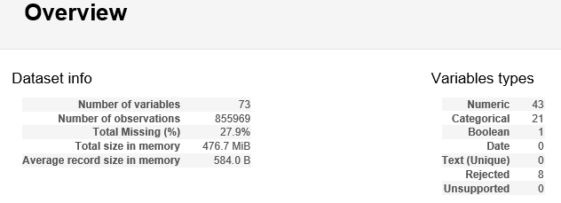
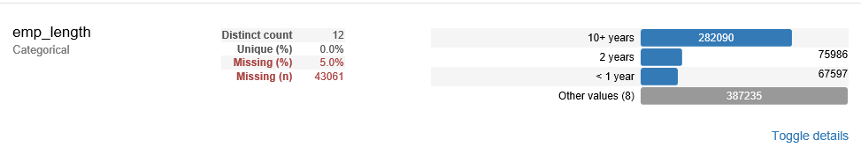
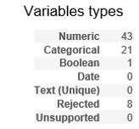

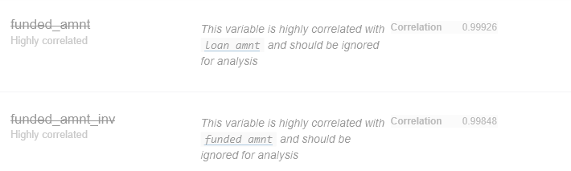
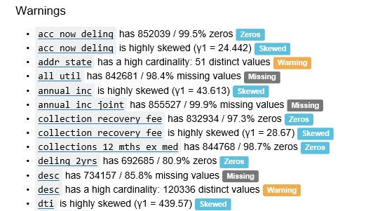
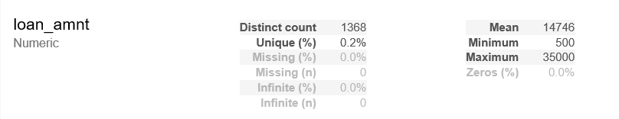
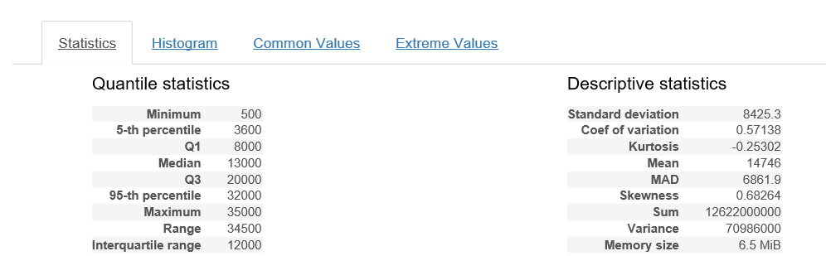
Pandas profiling
1
3
2
4
5
Minimum and maximum 5 values along with count and frequency %age

Slide 6
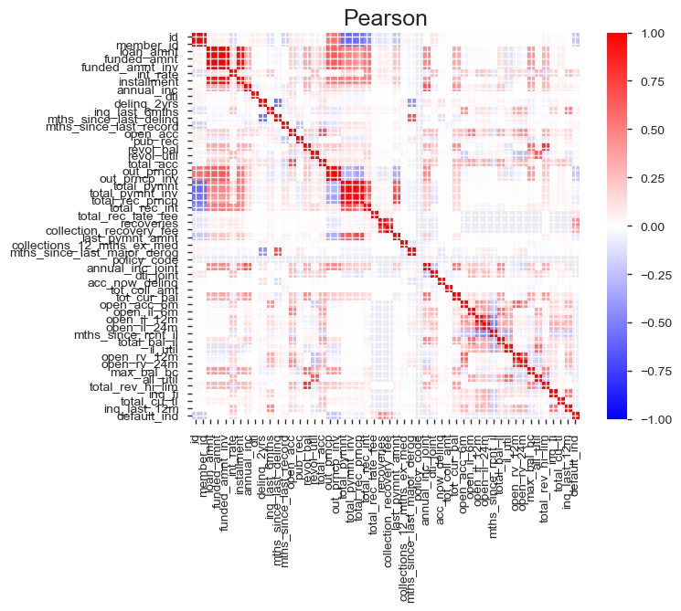

Pandas profiling
6
Pandas Profiling is a simple and highly efficient data exploratory tool used for data analysis of a Pandas Dataframe.
Can show important statistics such as : type, uniqueness, missing values, quartile statistics, Kurtosis, skewness. Can also display information in a visually attractive manner in the form of histograms

Slide 7


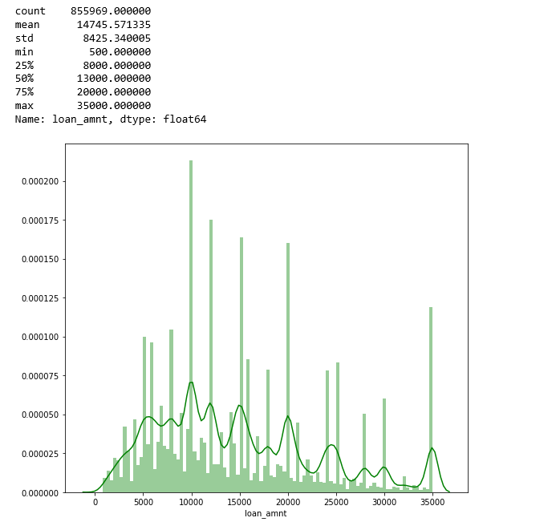
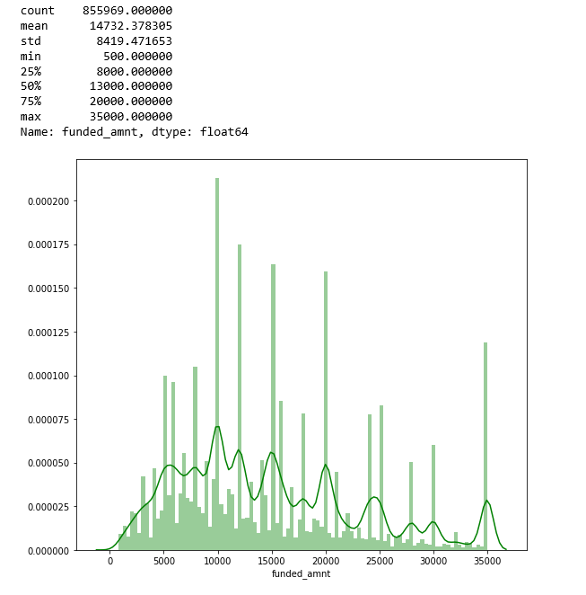
Visualization
Loan_amnt Distribution
funded_amnt Distribution

Slide 8
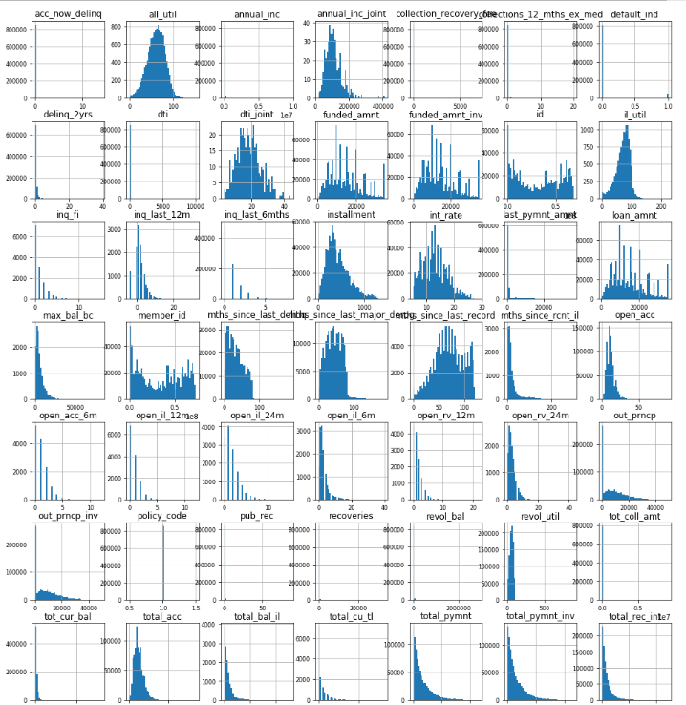
Visualization

Slide 9
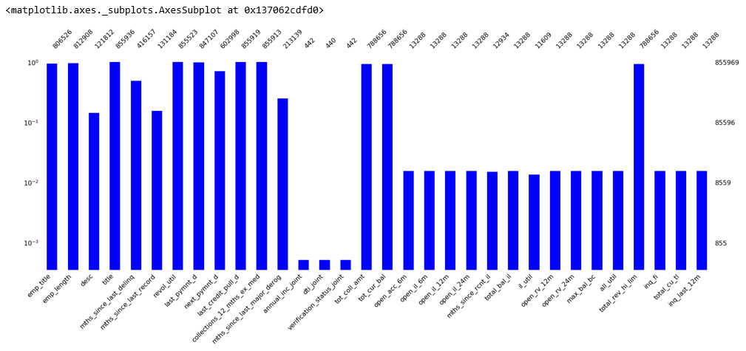
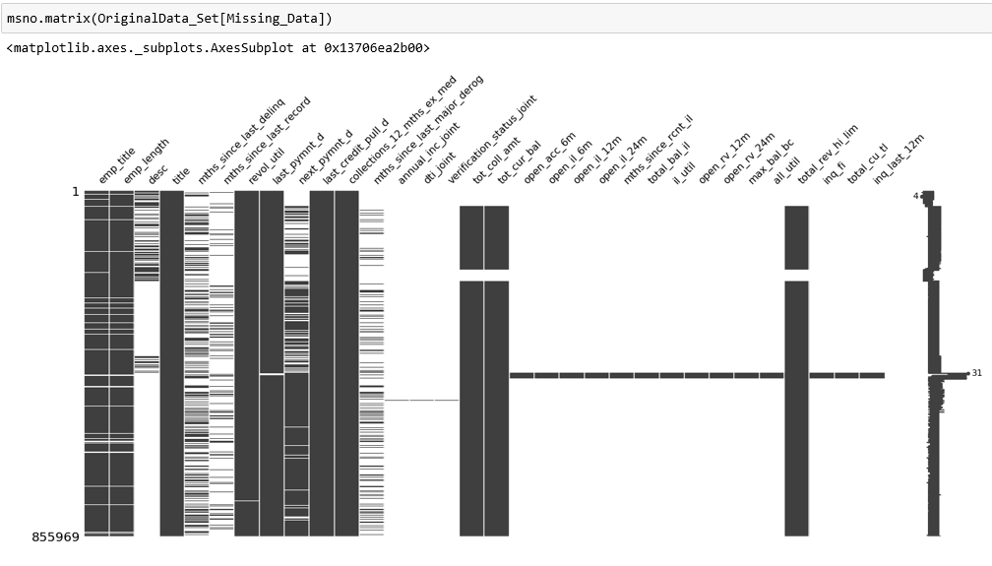
Missingno
MissingNo: It is missing value visualization tool used to expose a series of top-level Data Visualization taking pandas dataframe as input and gives up tweeked data nullity visualization as output

Slide 10
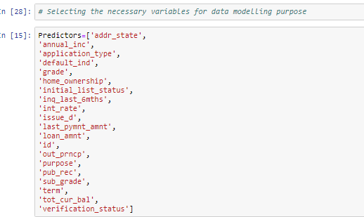
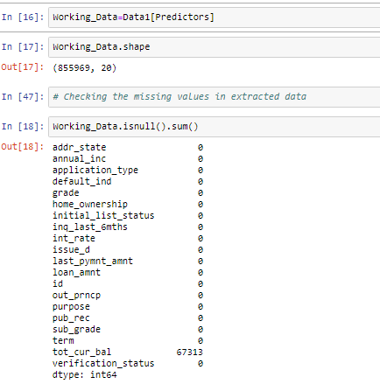
20 variables were considered for building the model
Out of 20 significant variables considered for modelling, only 1 had missing value .

Slide 11
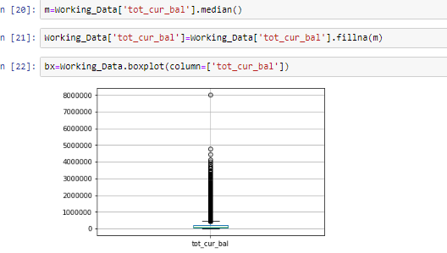
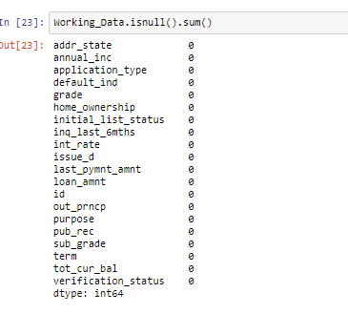
Missing value of variable “tot_cur_bal” was replaced with median value of the variable

Slide 12
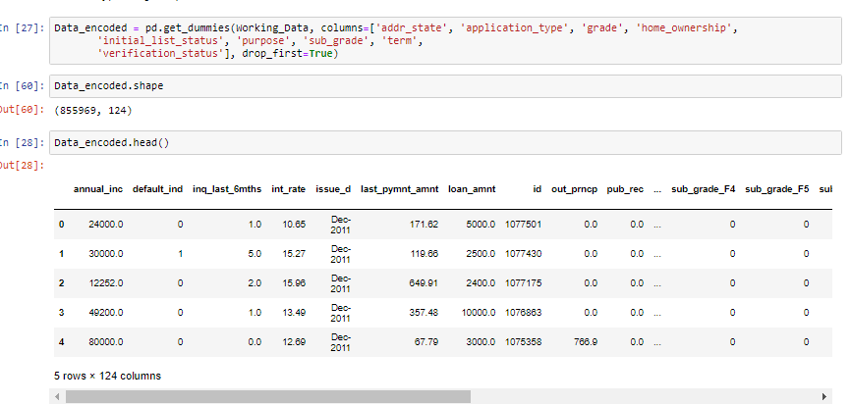
Hot Encoding the Object datatype
Hot encoding is used to perform “Binarization” of the category and include it as a feature to train the model
Variables : addr_state, application_type, grade, home_ownership, initial_list_status, purpose, sub_grade, term,
verification_status were hot encoded.

Slide 13
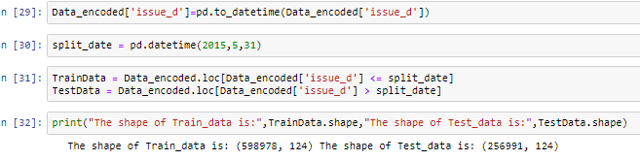
Splitting of Data into Train and Test Datasets on the basis of ‘issue_d’ variable

Slide 14
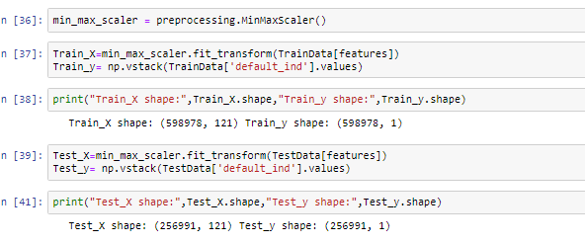
Using Min Max Scaler Train and Test set has been scaled to perform the prediction part.
Min Max Scaler: It transforms features by scaling each feature to a given range i.e, between 0 to 1

Slide 15
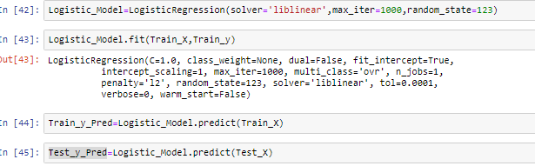
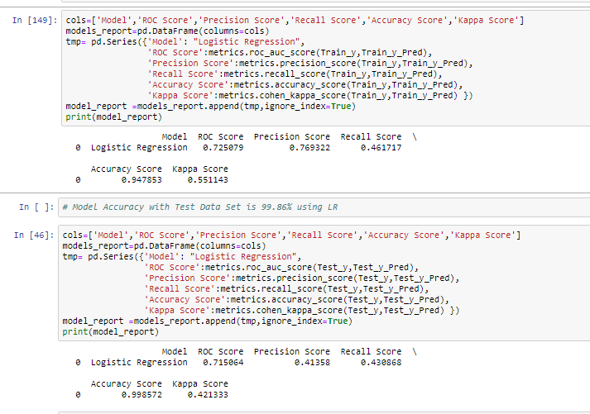
Logistic Regression Approach
Here we used the Logistic Regression Technique for the modelling purpose and find 94.78 % accuracy for the training set while for the test data set it goes higher to 99.85 %.

Slide 16
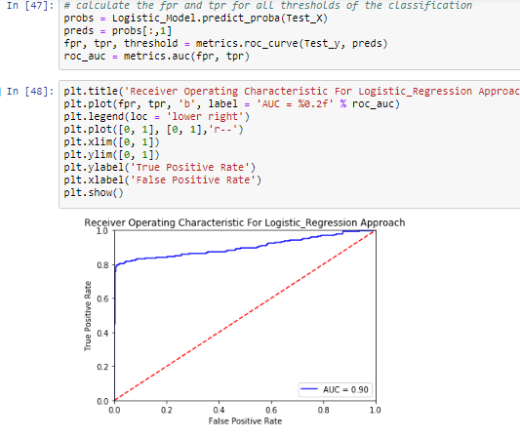
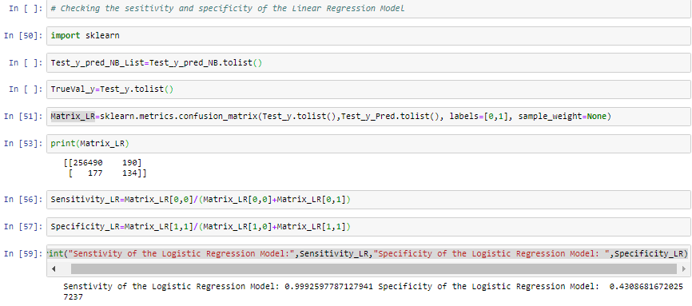
Model Sensitivity =99.92% (Identifying true positive ) Model Specificity=43.86% (Identifying true negative ) While AUC =.90

Slide 17
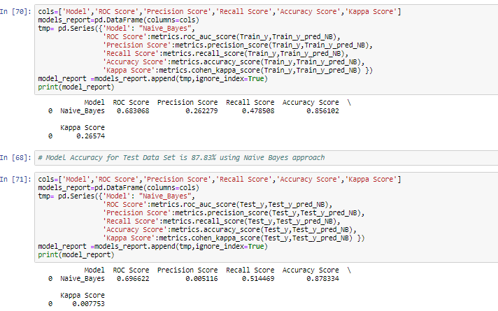
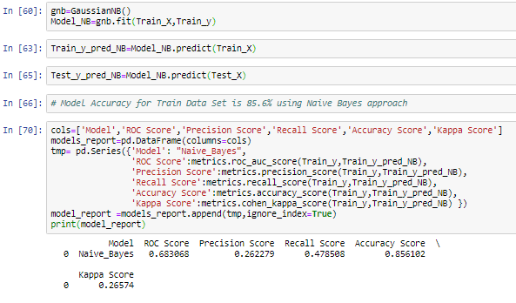
Naïve Bayes Technique
Using this approach the model accuracy for Train Data was 85.6% and for the Test Data it was recorded 87.83 %.

Slide 18
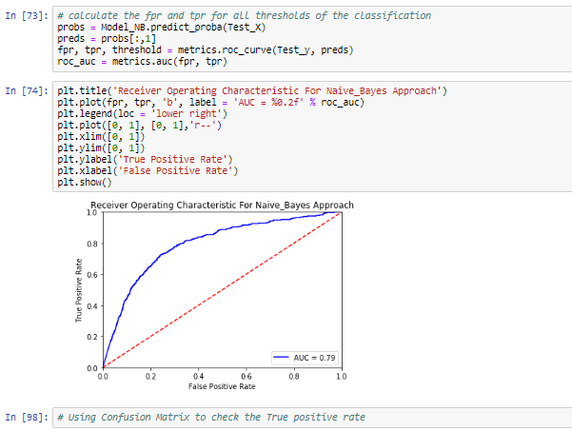
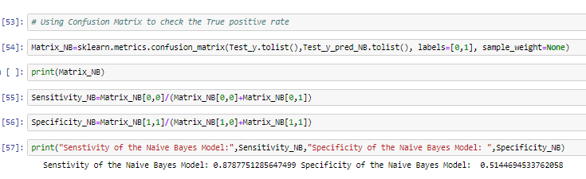
Model Sensitivity =87.87% (Identifying true positive ) Model Specificity=51.44% (Identifying true negative ) While AUC =.79

Slide 19
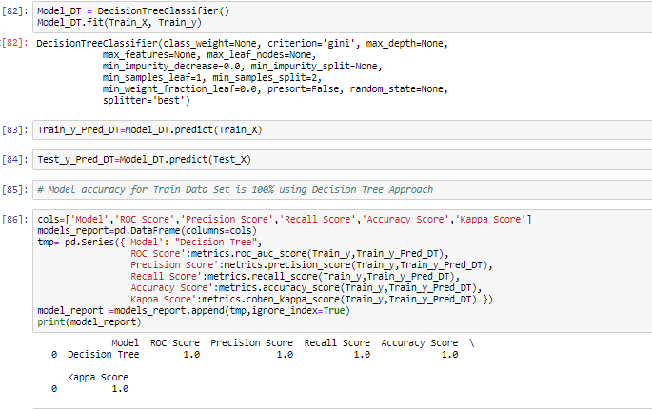
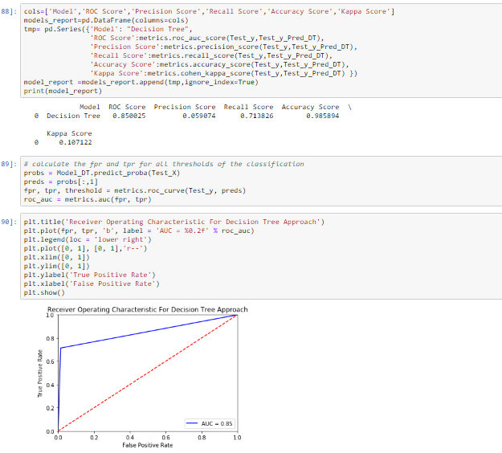
Decision Tree Classifier
Model Accuracy for Training Data set was obtained 100%,
While for the Test Data Set it was recorded 98.54%.

Slide 20
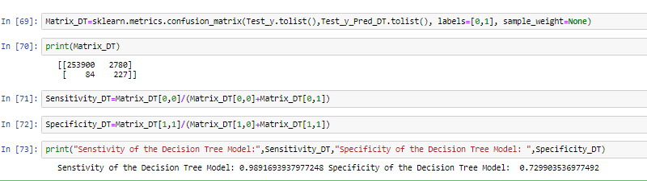
For the Decision Tree Model :
Model Sensitivity =87.87% (Identifying true positive ) Model Specificity=51.44% (Identifying true negative ) While AUC =.79

Slide 21
Model Comparison :-
MODEL NAME | ACCURACY | SENSTIVITY | SPECIFICITY
LOGISTIC REGRESSION | 99.85 % | 99.92% | 43.86%
NAÏVE BAYES | 87.83 % | 87.87 % | 51.44%
DECISION TREE | 98.54 % | 98.91 % | 72.99 %
Findings :
We have found the accuracy of 98.54 % for Test Dataset taking Decision Tree as the best model with Sensitivity of 98.91% and Specificity rate of 72.99%.

Slide 22
THANK YOU

